Slide 1



Department of Computer Science Engineering
Nayan Nirikshan
Violence Detection System using Surveillance Camera
Language and Image Processing Project
Subhash B S I Harsha R I Nityanand Kumar I Sumanth Hegde
Under the Guidance of: Prof. Mrs. Bhagyashri Wakde

Slide 2




Nayan Nirikshan
Advance Violence Detection System using Surveillance Camera

Slide 3

01
Abstract
Info on our project
02
Motivation behind Project
Story Time
03
Modules involved
Some serious stuff
04
Key features
Random stuff
05
Conclusion
Experience

Slide 4
ABSTRACT
B
S
C
T
A
T
R
A
Overview of project work

Slide 5


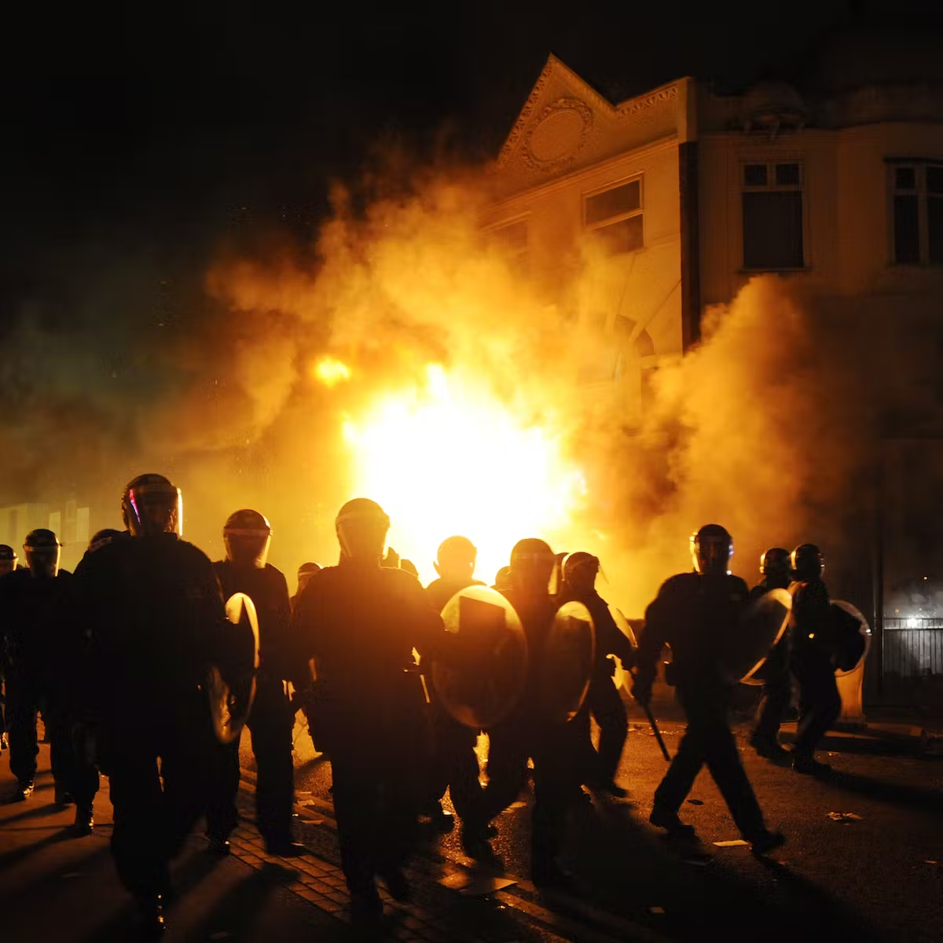
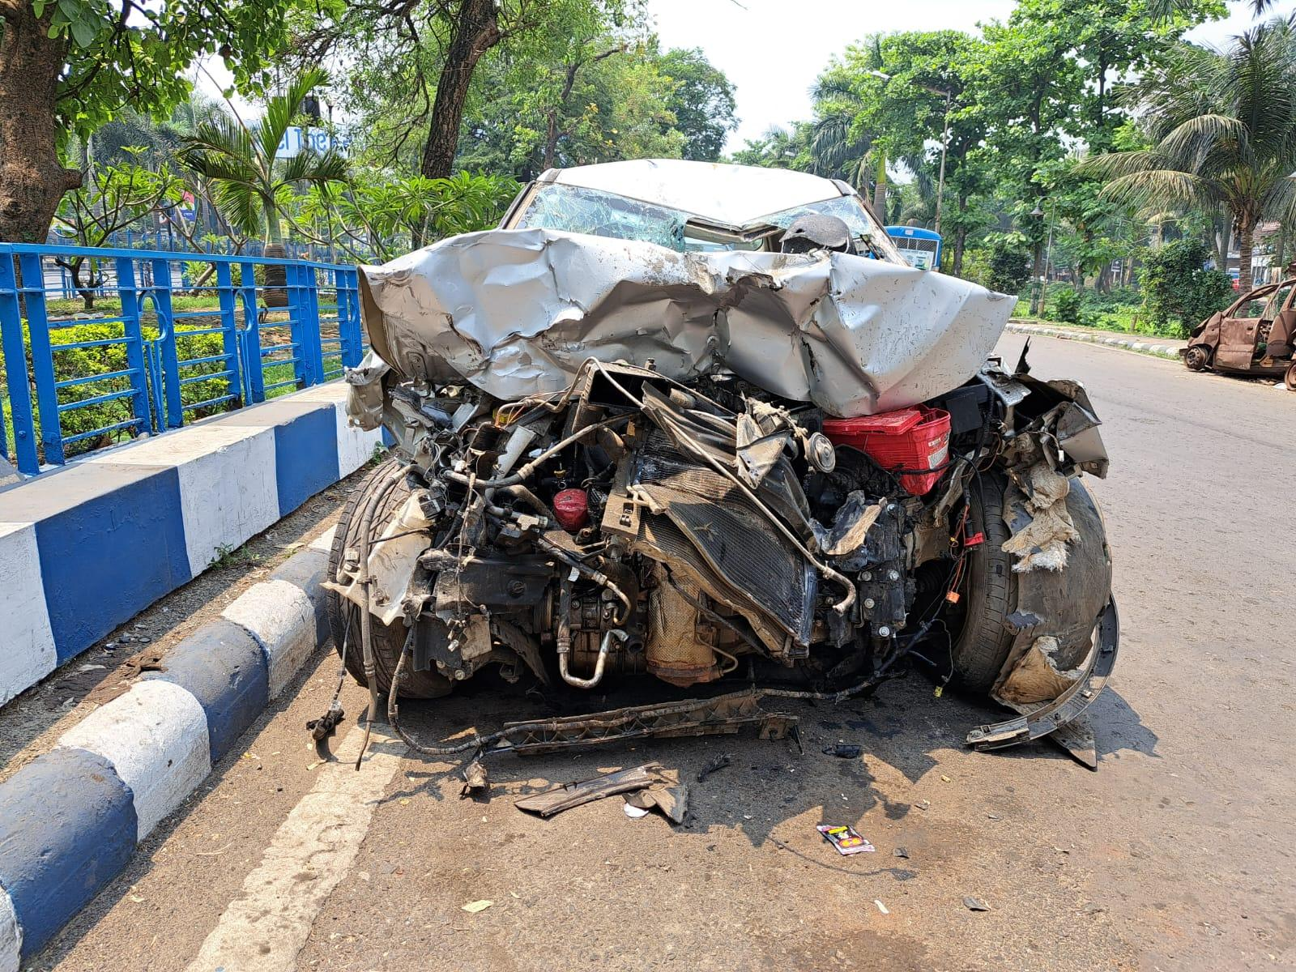
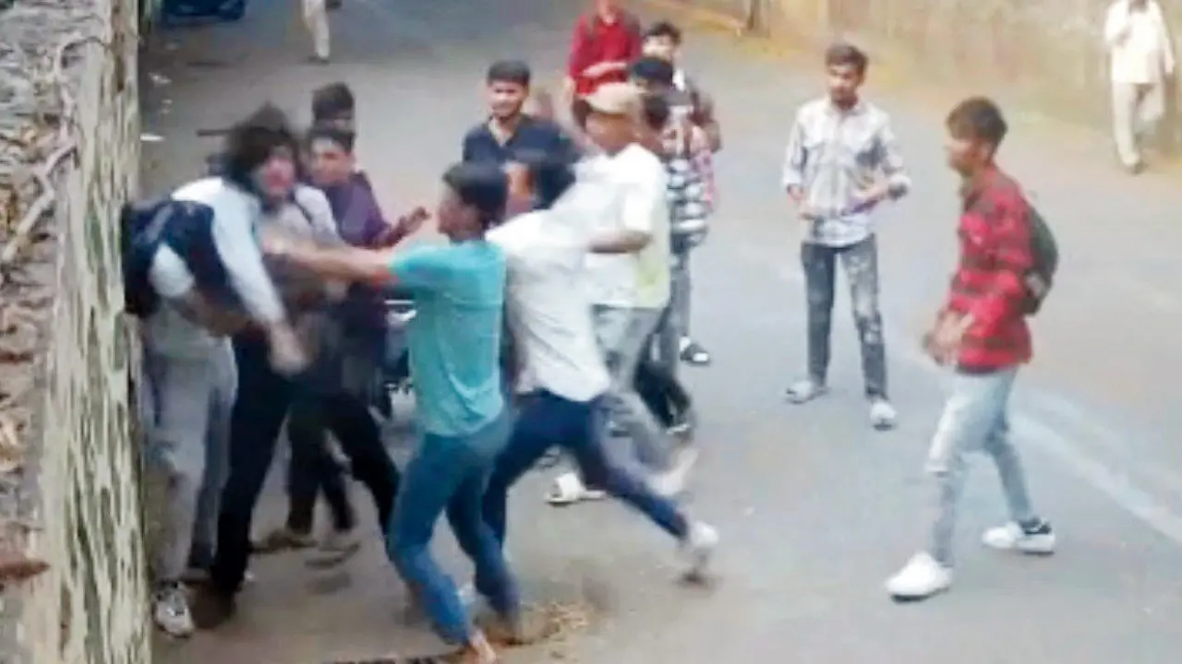


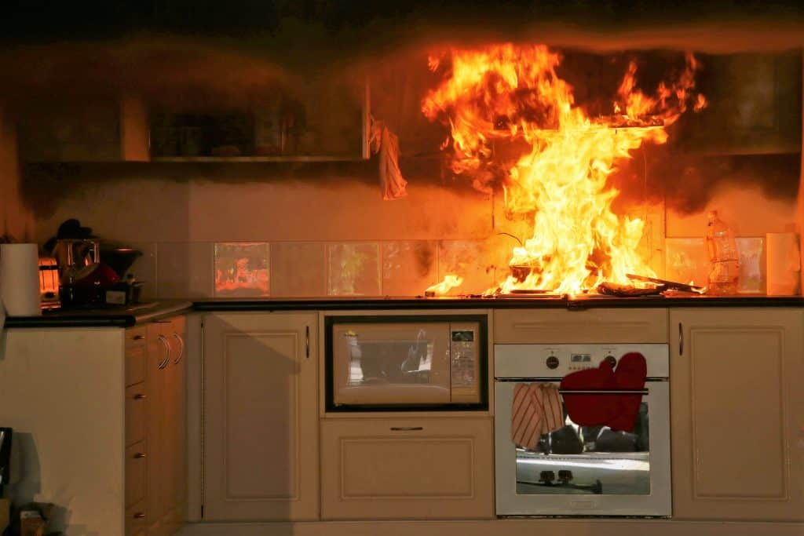



MOTIVATION TO PROJECT
Crash
Ragging
Riots
Street Fight
Fire
Domestic Violence

Slide 6

SYSTEM MODULES
1
DATA PREPARATION
Data Preparation
Collection and preparation of good quality data for Training.
2
Model Training
Training the model using the collected data.
MODEL EVALUATION
MODEL TRAINING
3
Model Evaluation
Evaluation of our trained model for performance analysis.

Slide 7
KEY FEATURES OF SYSTEM
KEY FEATURES OF SYSTEM
Not Limited to Violence
Smart Alert System
Our model's capabilities extend beyond violence detection, allowing for a wide range of potential applications in the realm of public safety and security.
Our model can alert authorized personnel through the messaging app Telegram, allowing for quick and effective response to potential threats.
INTELIGENT
LOW MAINTENANCE
1
4
2
3
# Outside
# Inside
Our model has the ability to detect and classify various outdoor activities, making it a valuable tool for enhancing safety and security in public spaces.
BEST IN MARKET
SECURITY.
Our model has the ability to detect and classify various indoor activities, making it a valuable tool for enhancing safety and security in indoor environments

Slide 8
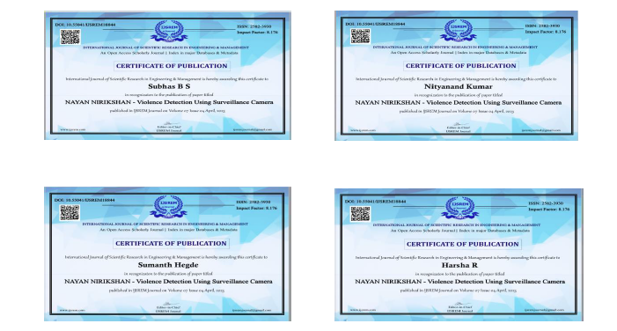
JOURNAL PAPER
Journal Category: Computer Science & Technology
Publication Time: 2-3 weeks
Acceptance Rate: 26%
Publication website: IJSREM
Impact Factor: 8.76
Cite Score: 8.2
Status of Journal: PUBLISHED

Slide 9
The completion of the work.
D
E
M
0
Nayan Nirikshan

Slide 10

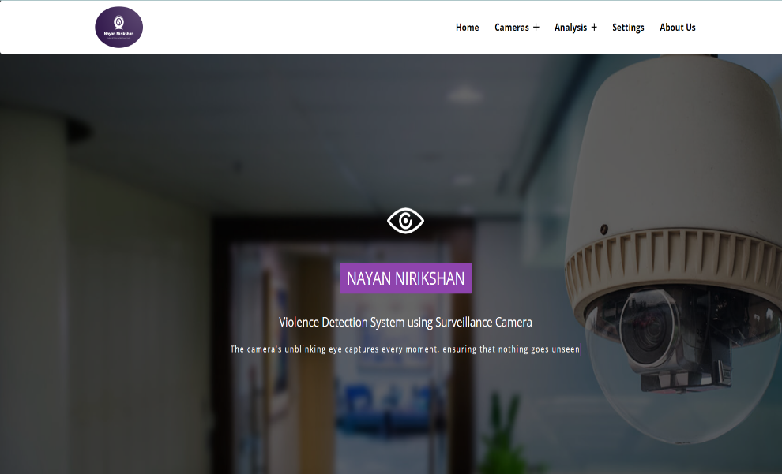



CONCLUSION
This project has motivated us to develop a versatile violence detection system using surveillance cameras that can enhance safety and security in public spaces, both indoors and outdoors. Moving forward, we are excited to continue exploring other potential applications of this technology to make a positive impact on the safety of individuals and communities.

Slide 11
NAYAN NIRIKSHAN
Thank you

Slide 12




Q&A
ANY QUESTIONS..?

